Slide 1
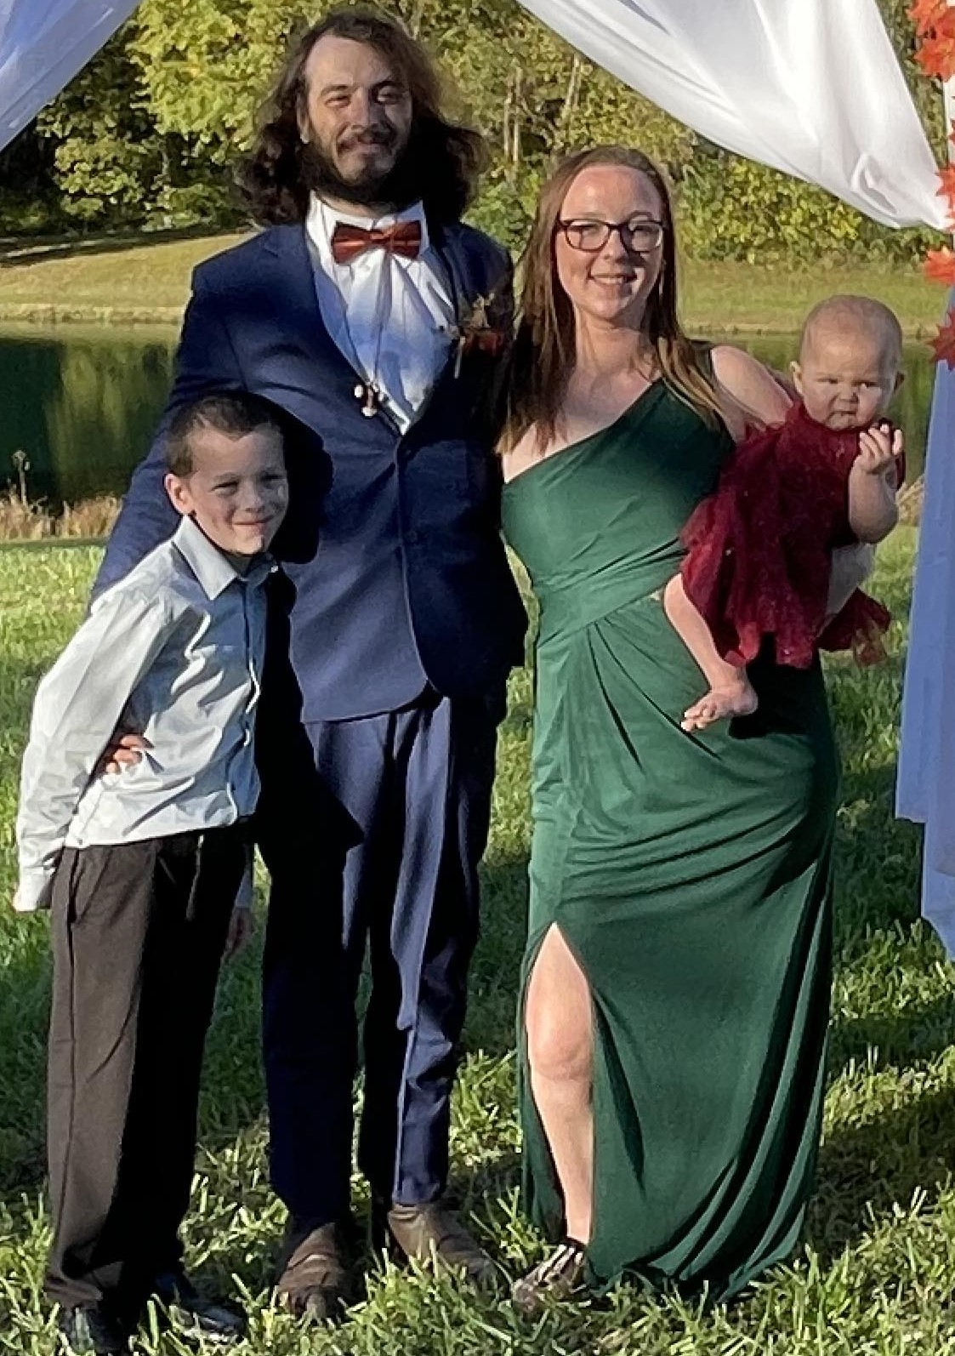
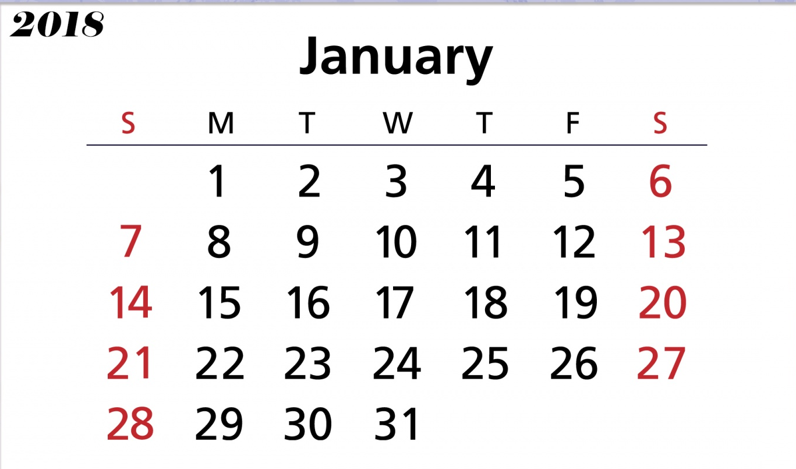



Home Parents page Lucas’ Page Octavia’s page
The Fonnegra Family
Name:
Questions and Comments

Slide 2
Contact Page
Questions or Comments Form
Enter Your Name:
Questions and Comments:
Submit Reset.

Slide 3
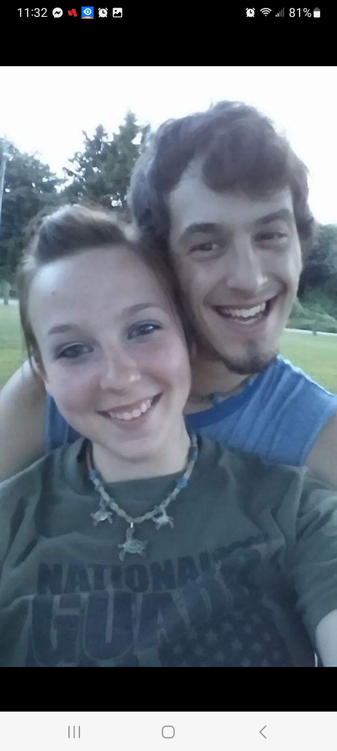
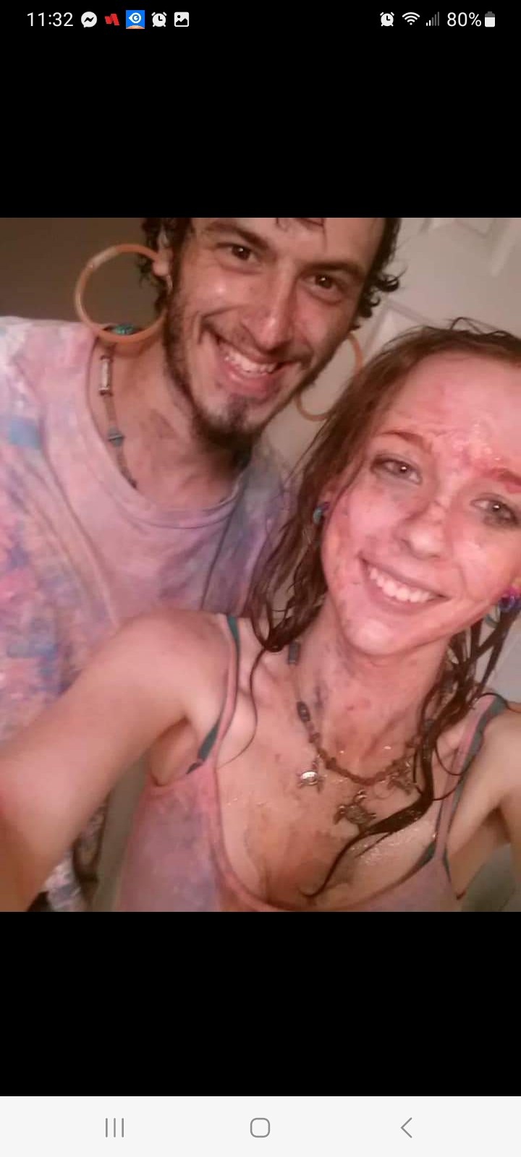
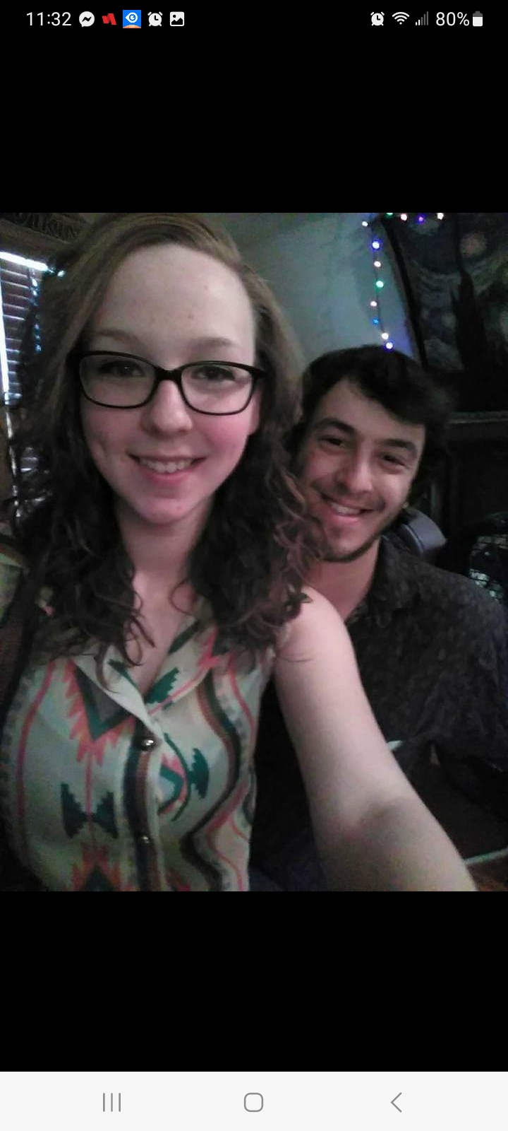
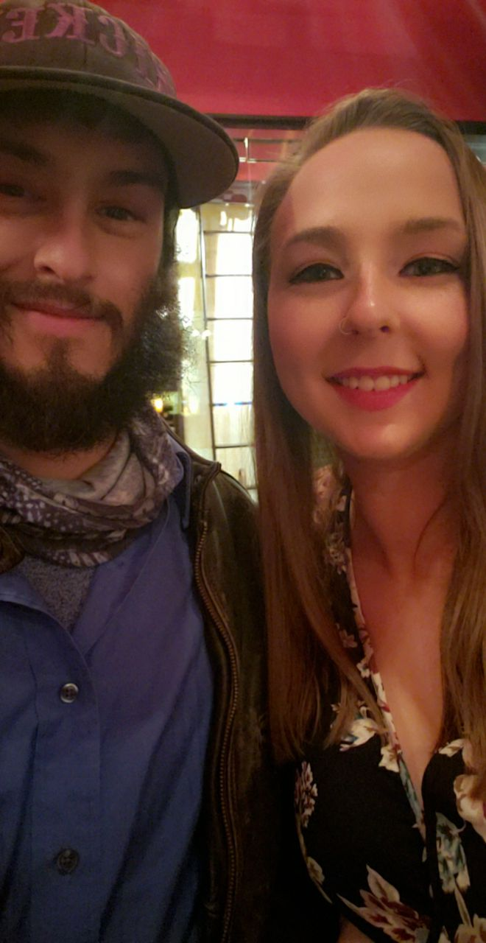
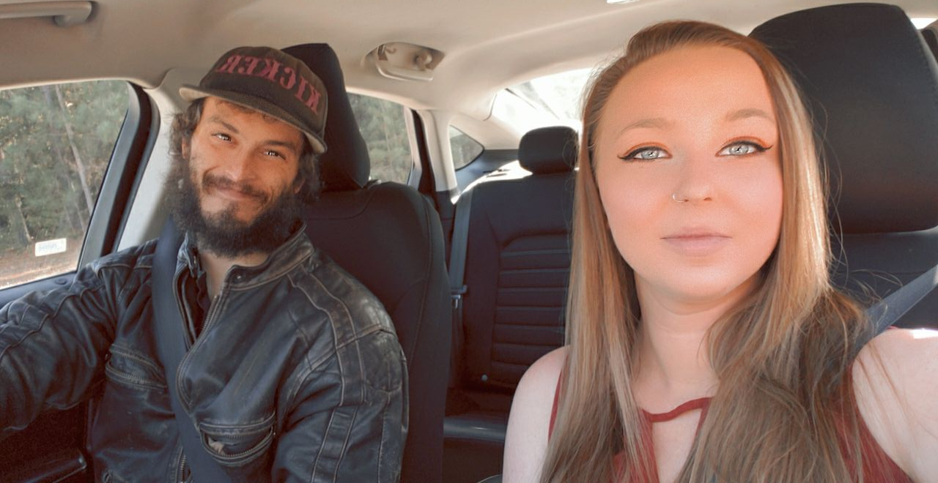
About the parents
Morgan and Adrian met almost 10 years ago. We were together for two years before introducing our wonderful son Lucas into the world and nine years before introducing our daughter.
With all of our memories together. The memories we love the most is having our two amazing children. They both have been the best thing that has ever happened to us.

Slide 4
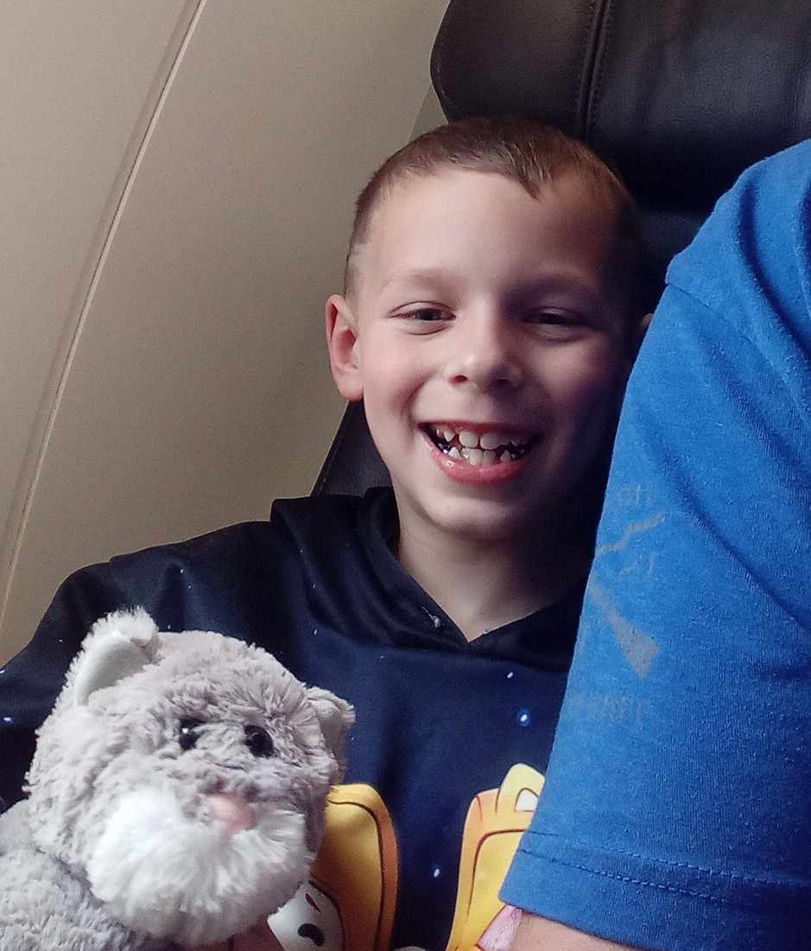
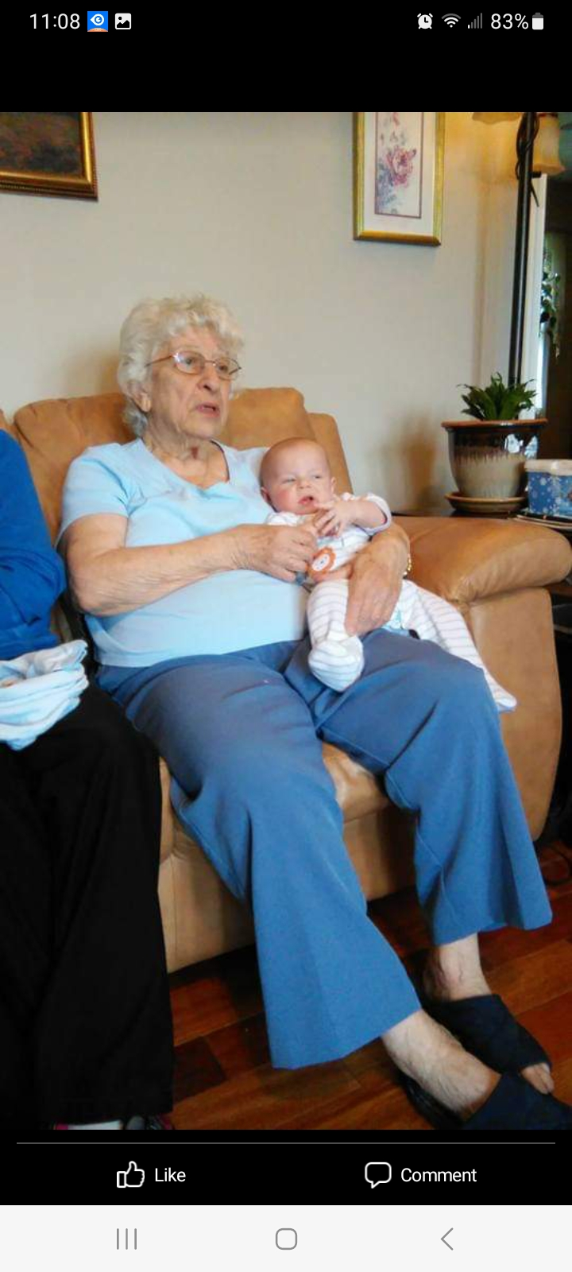
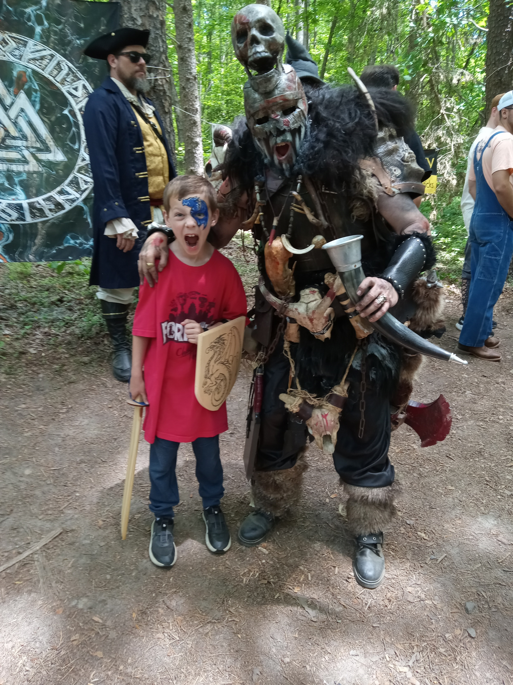
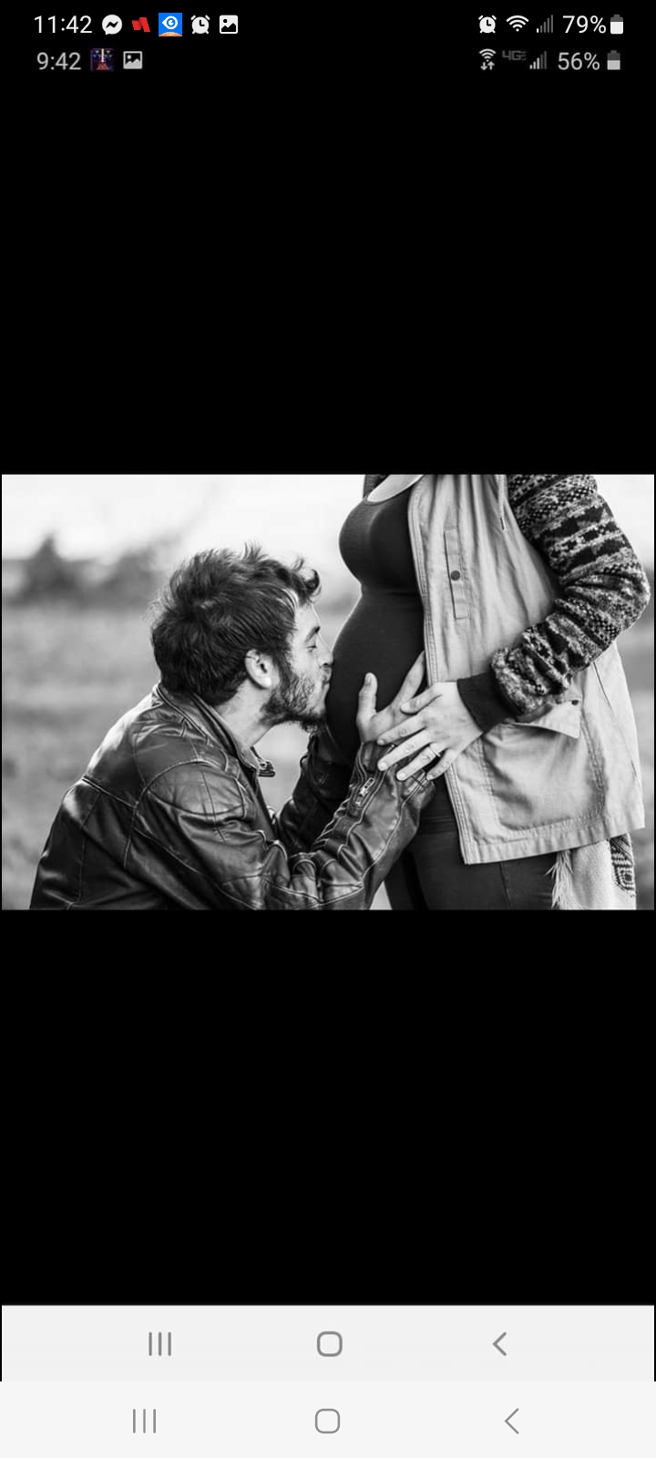
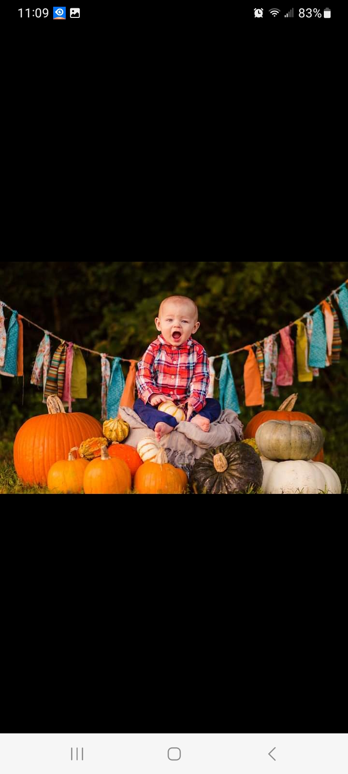
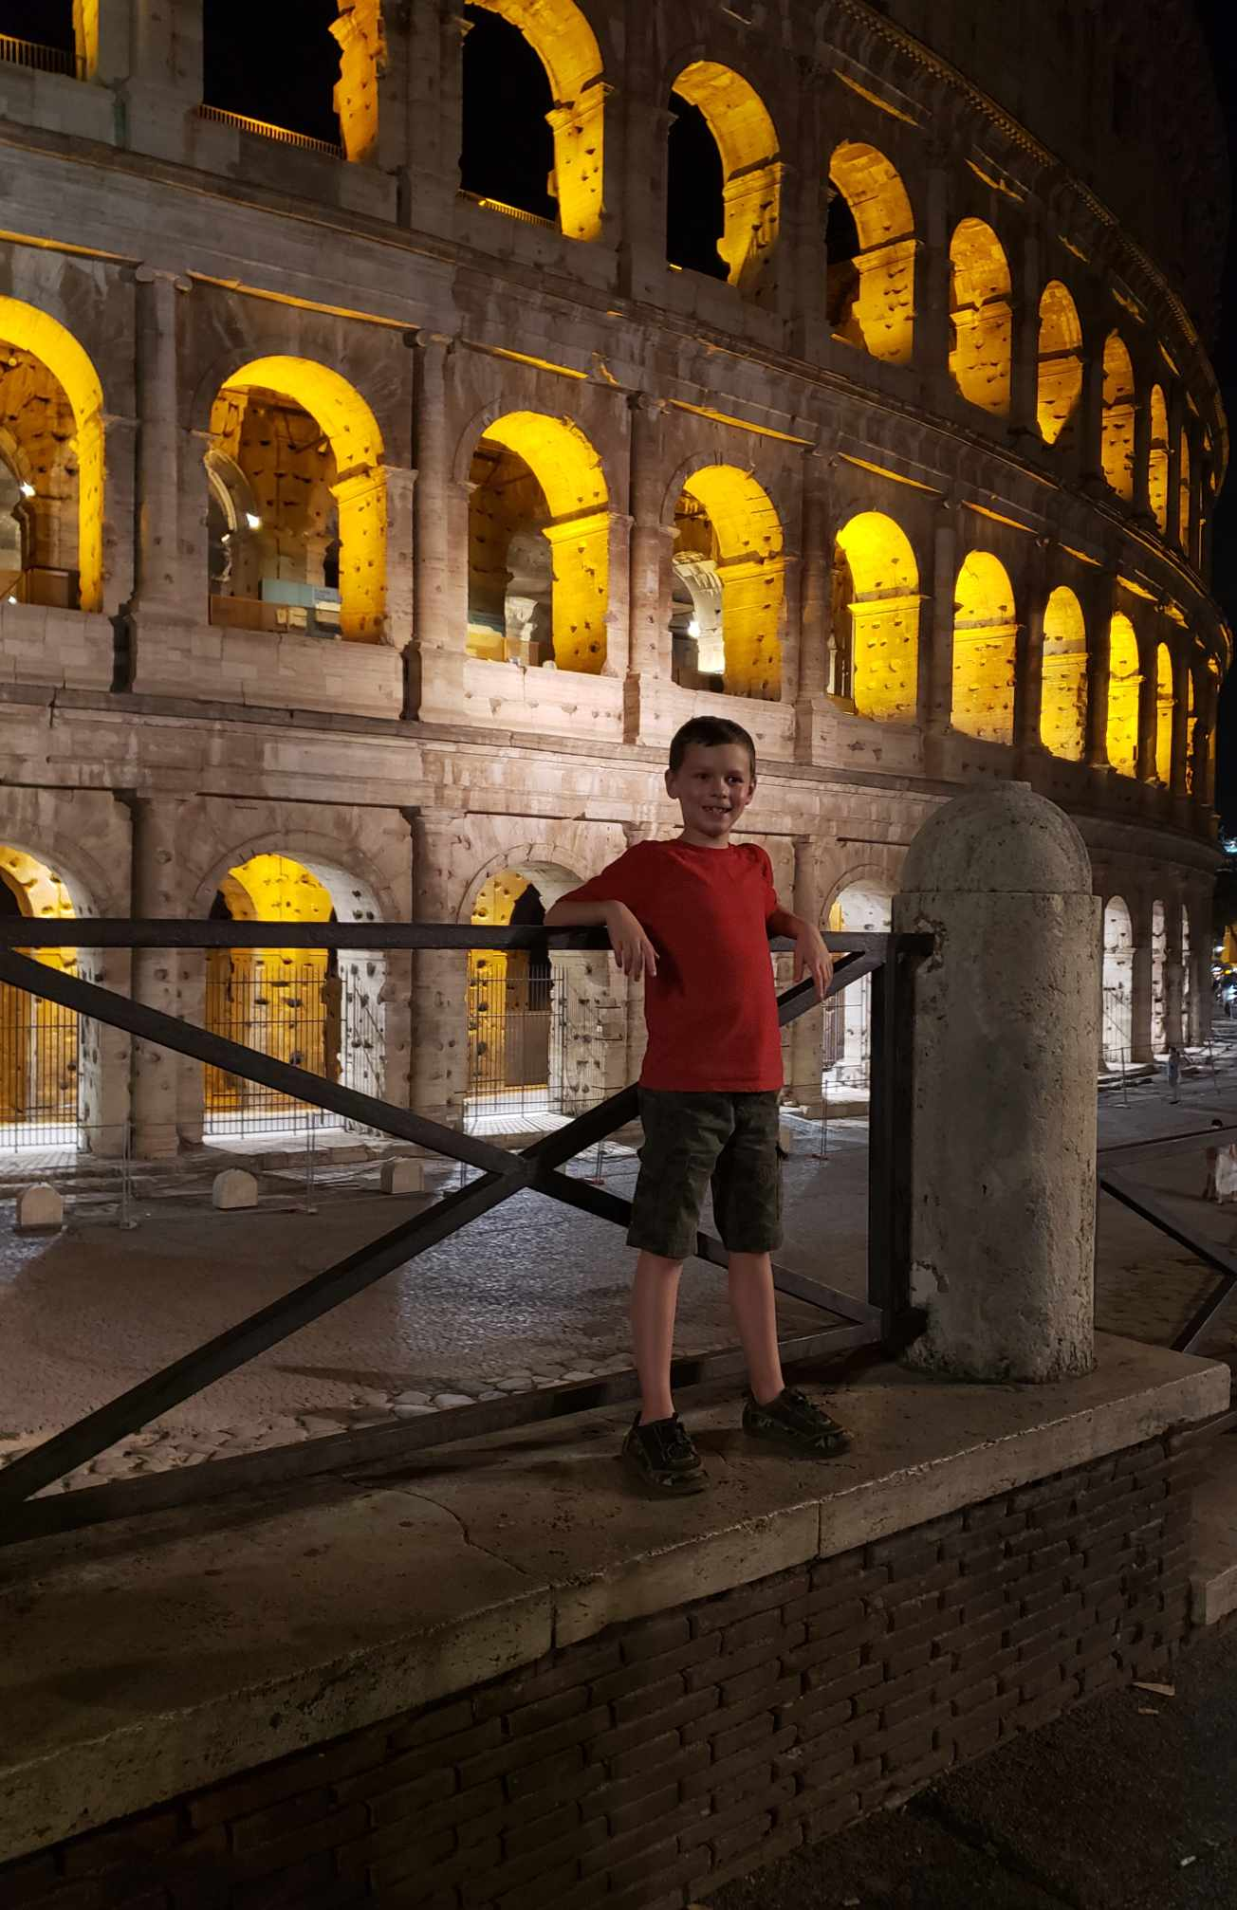
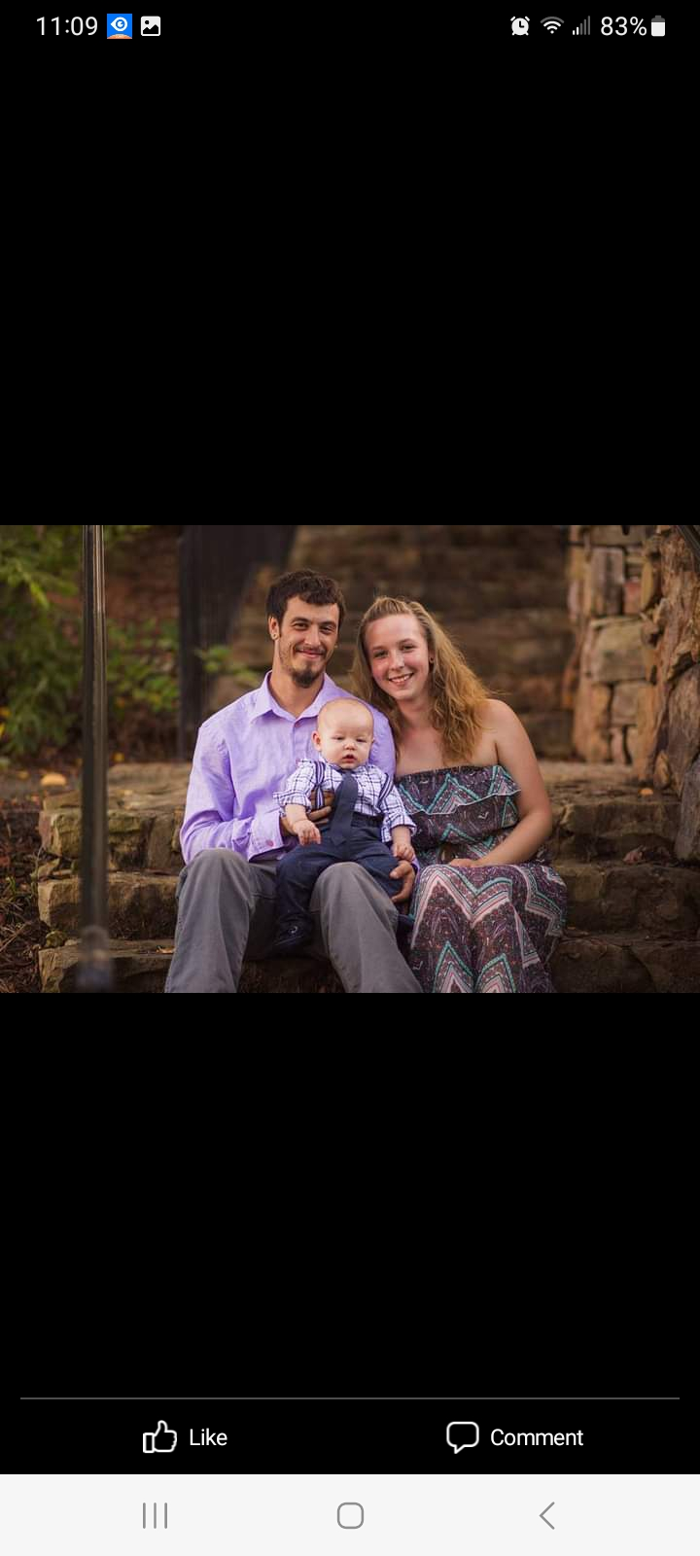
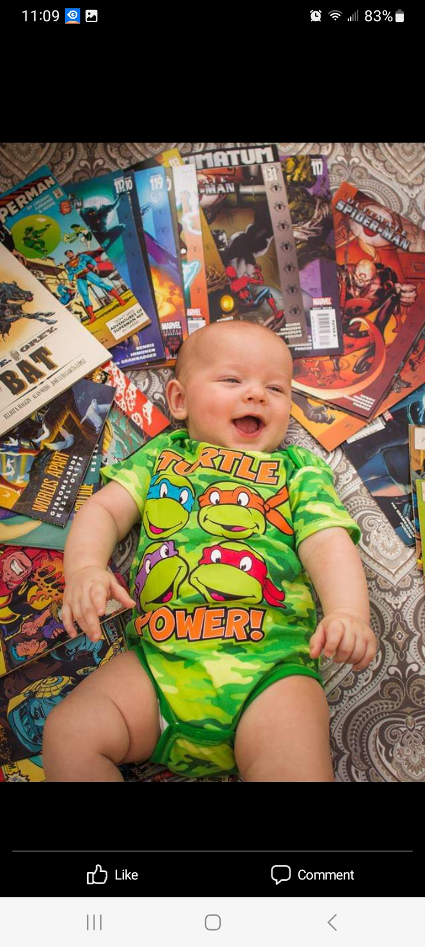
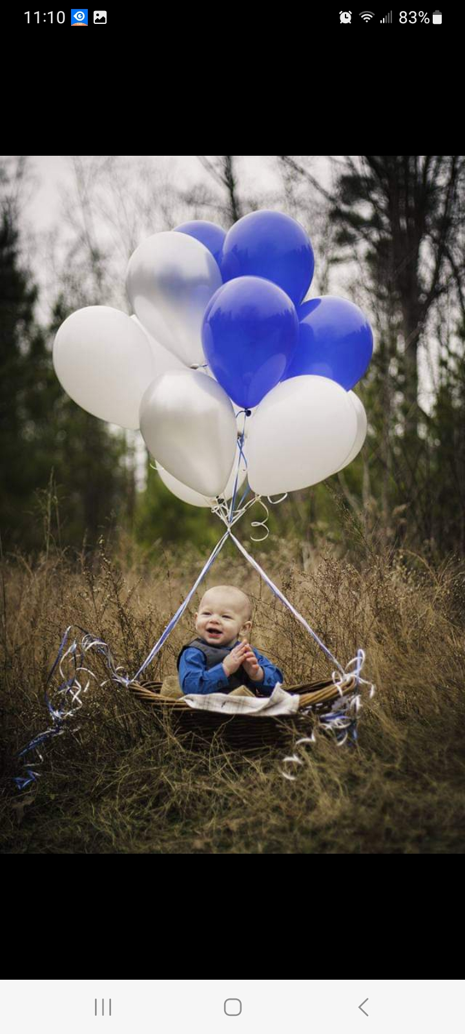
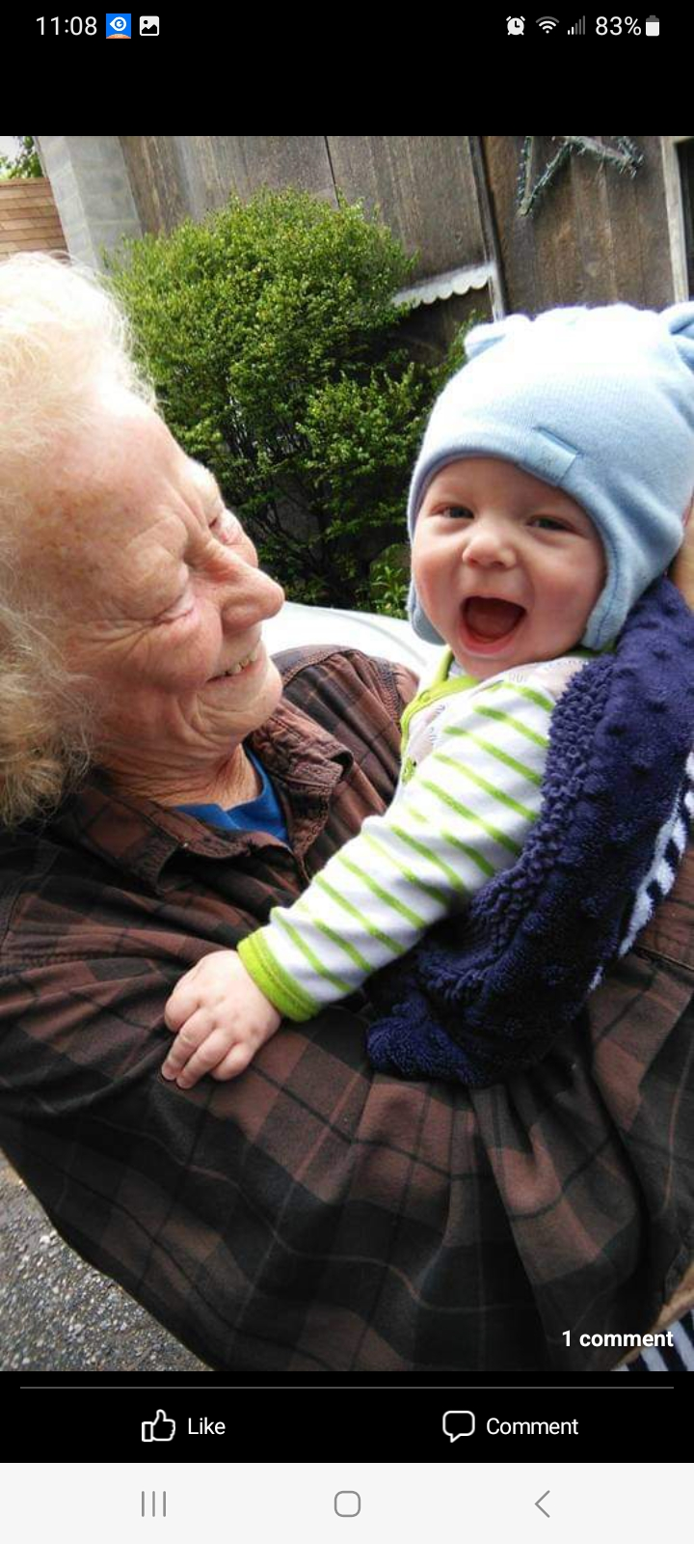
Lucas’ Page
Lucas was born on December 11th. He brought so much joy in our life. He is now almost 8 years-old and has visited Germany, Rome, and Paris. Talk about spoiled. Lucas was the only one of the grandchild to meet his great great grandmother.

Slide 5
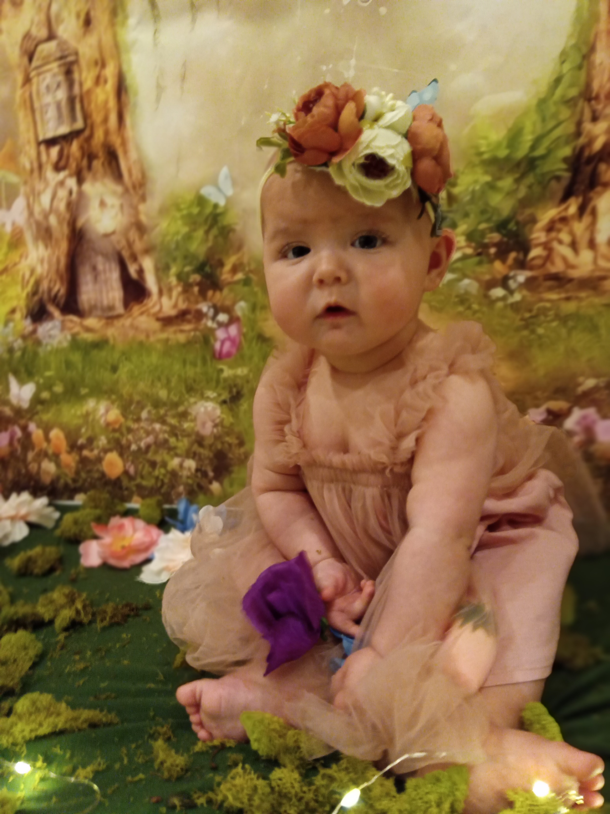
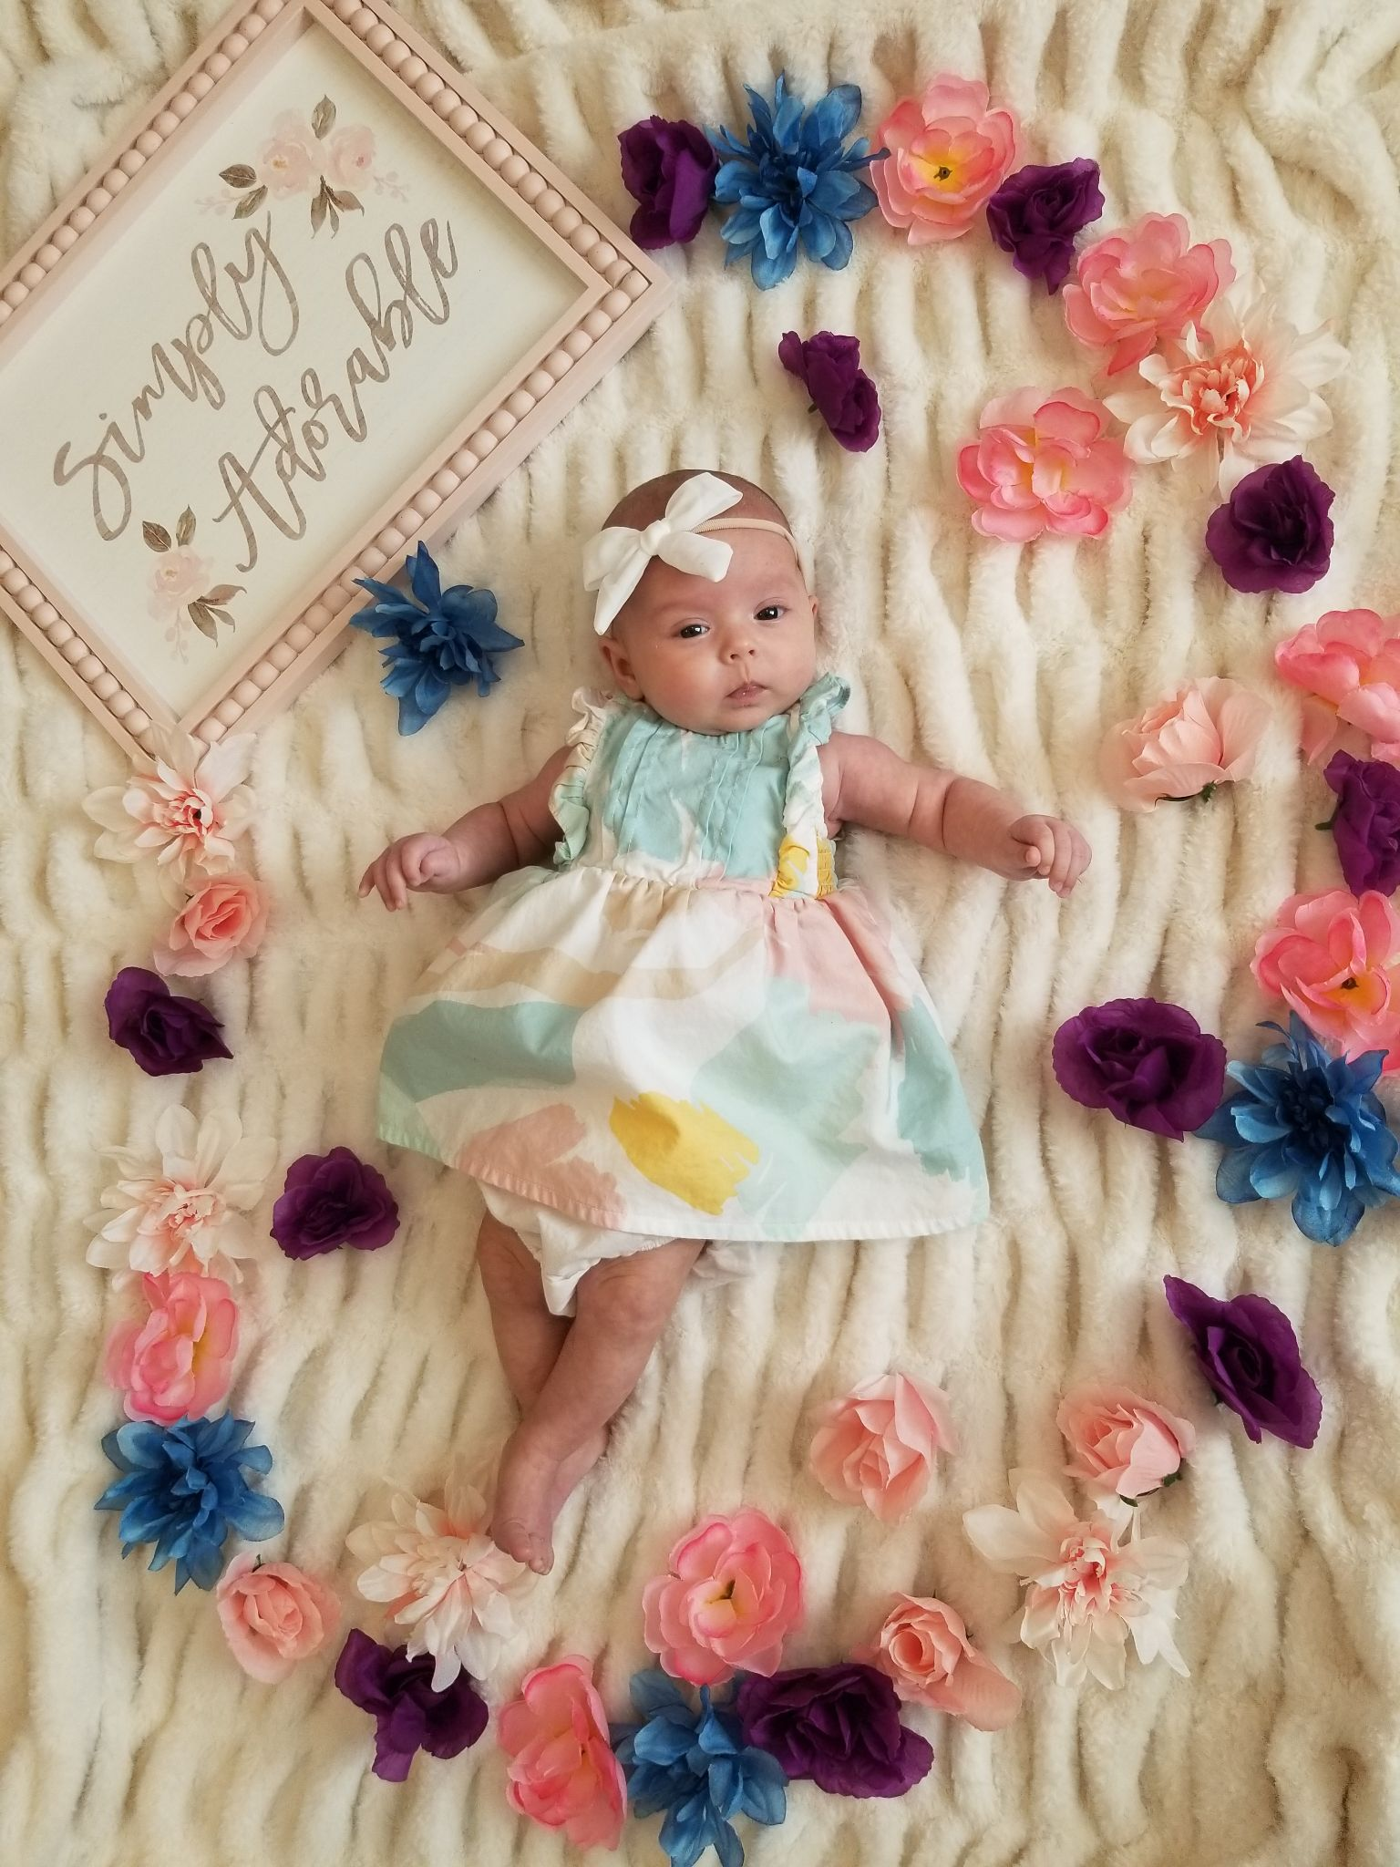
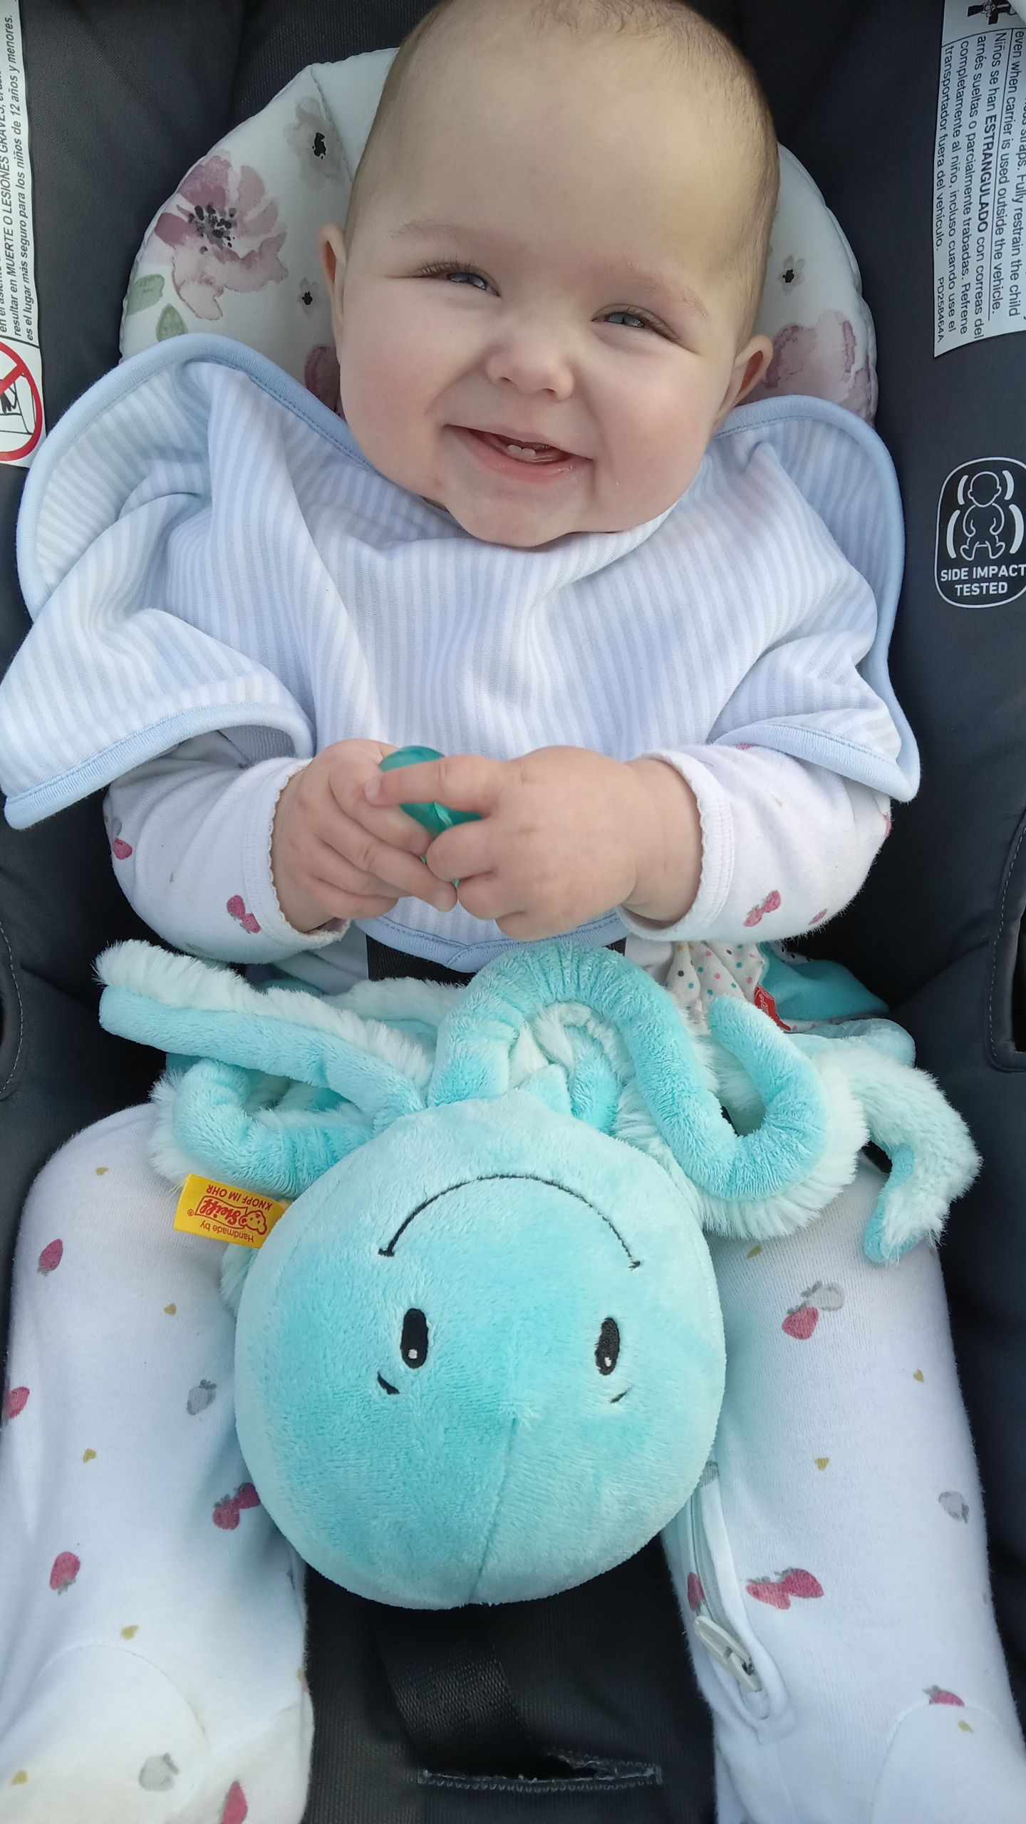
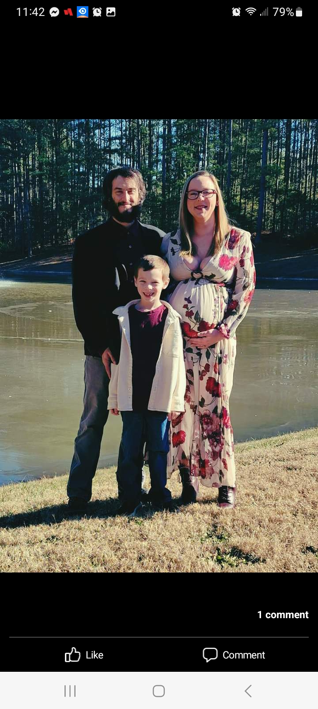
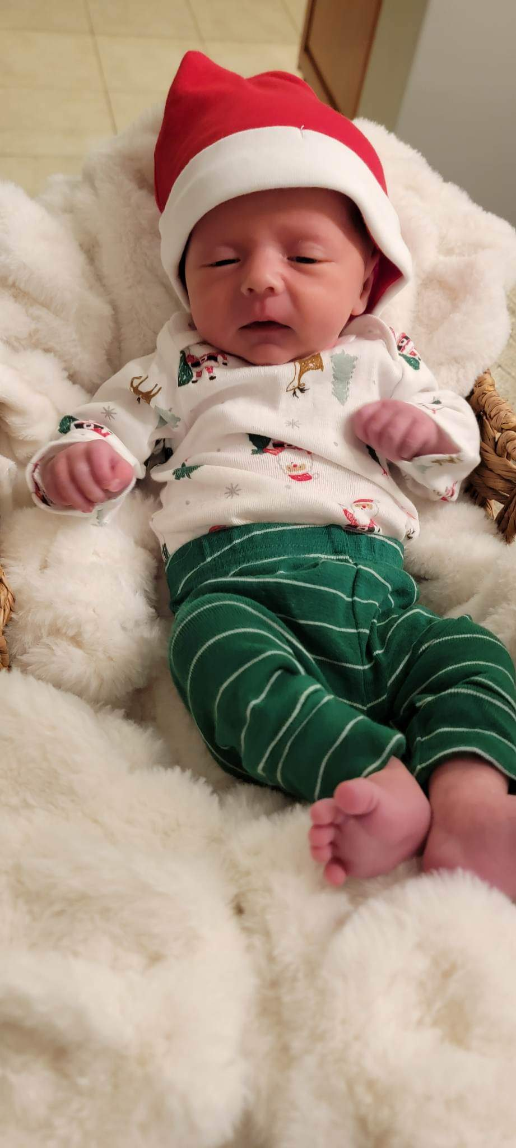
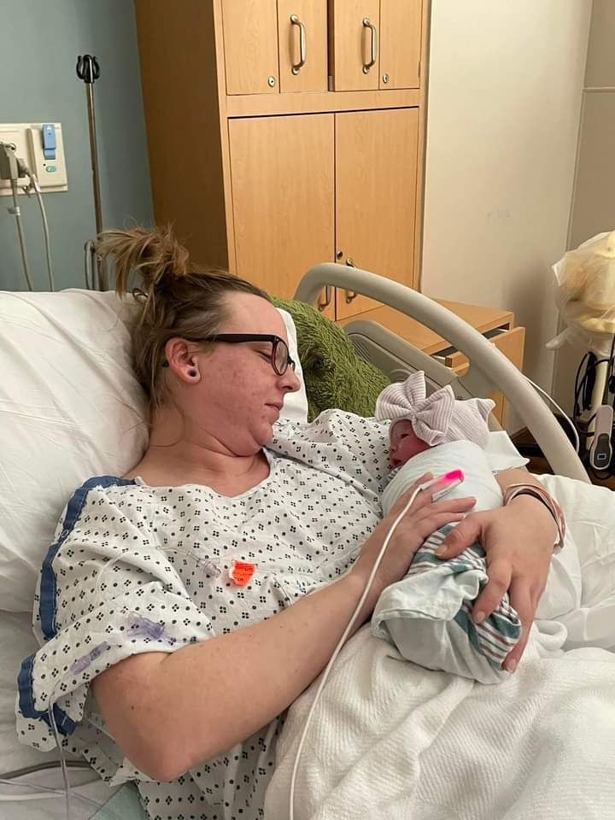
Octavia was welcomed into this world on the 28th of December. She is only 8 months at this moment. She mainly loves mom and is always needing her. She loves to play with her brother. She just learned to crawl and working on trying to pull herself up to walk! She’s full of attitude and ready to rule the world!
Octavia’s Page

